Slide 1
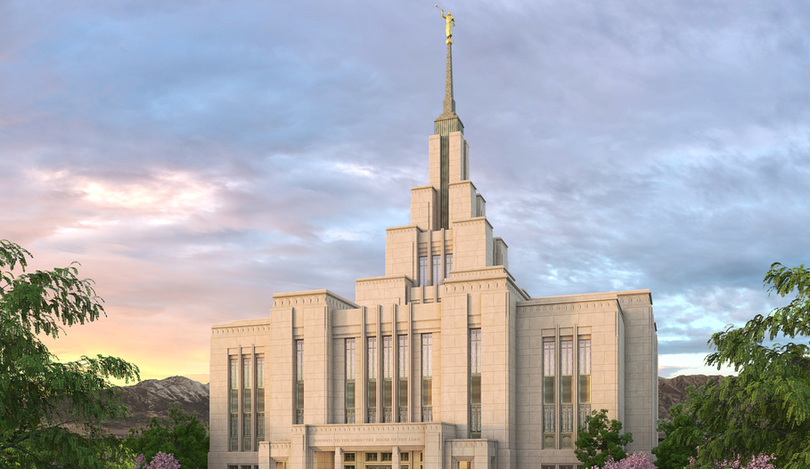
Temple and Family History 2020
Dry Creek Ward

Slide 2
Welcome and Video Presentation
https://youtu.be/QaGSaaKX4gcu
Notes:
Bishopric - 5 minutes, should be over by 1:15
Welcome
Elder Renlund Video
Blessings of the temple (Apr 2018 Conf.)
Testimonies

Slide 3
“...To gather and unite God’s family requires more than just warm feelings. It requires sacred covenants made in connection with priesthood ordinances.
Many of your ancestors did not receive those ordinances. But in the providence of God, you did. And God knew that you would feel drawn to your ancestors in love and that you would have the technology necessary to identify them. He also knew that you would live in a time when access to holy temples, where the ordinances can be performed, would be greater than ever in history. And He knew that He could trust you to accomplish this work in behalf of your ancestors.”
-- President Henry B. Eyring --

Slide 4
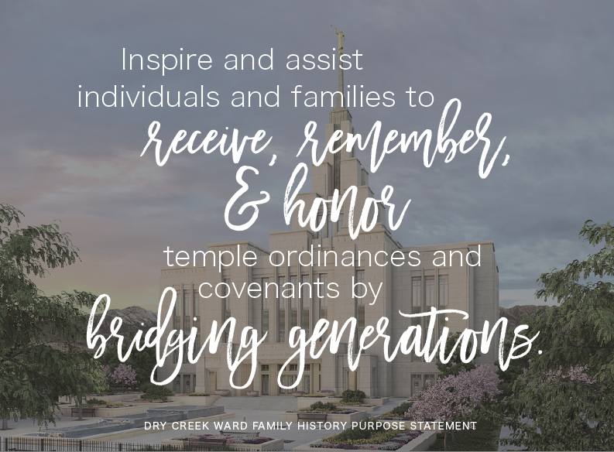
Notes:
President Rasmussen
Goal

Slide 5
Agenda
Family Search and Related Apps
Home Centered Activities
Ward Activities for the Coming Year
This meeting is just an introduction. “How to” will come later.
Notes:
President Rasmussen - Should be over by 1:25
Show Overview of topics for the day
Explain this is not a “How To”. That comes later

Slide 6
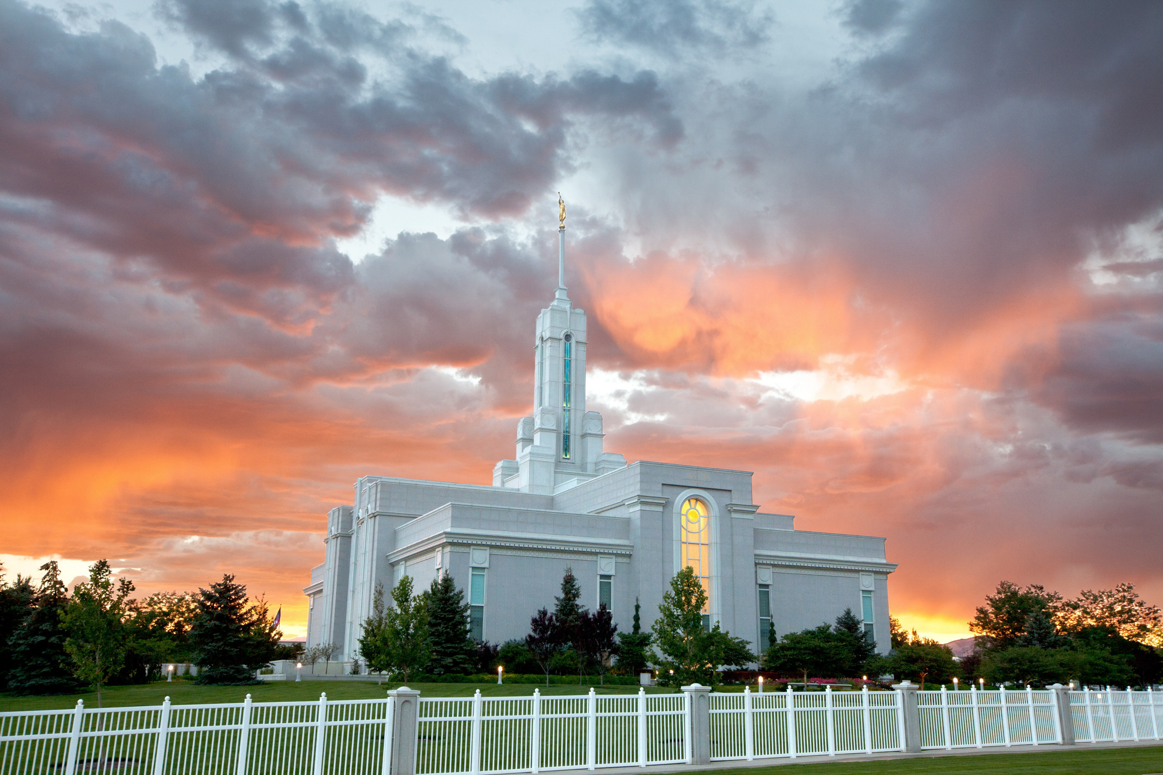
Family Search and Related Apps

Slide 7
Relative Finder Exercise

Slide 8
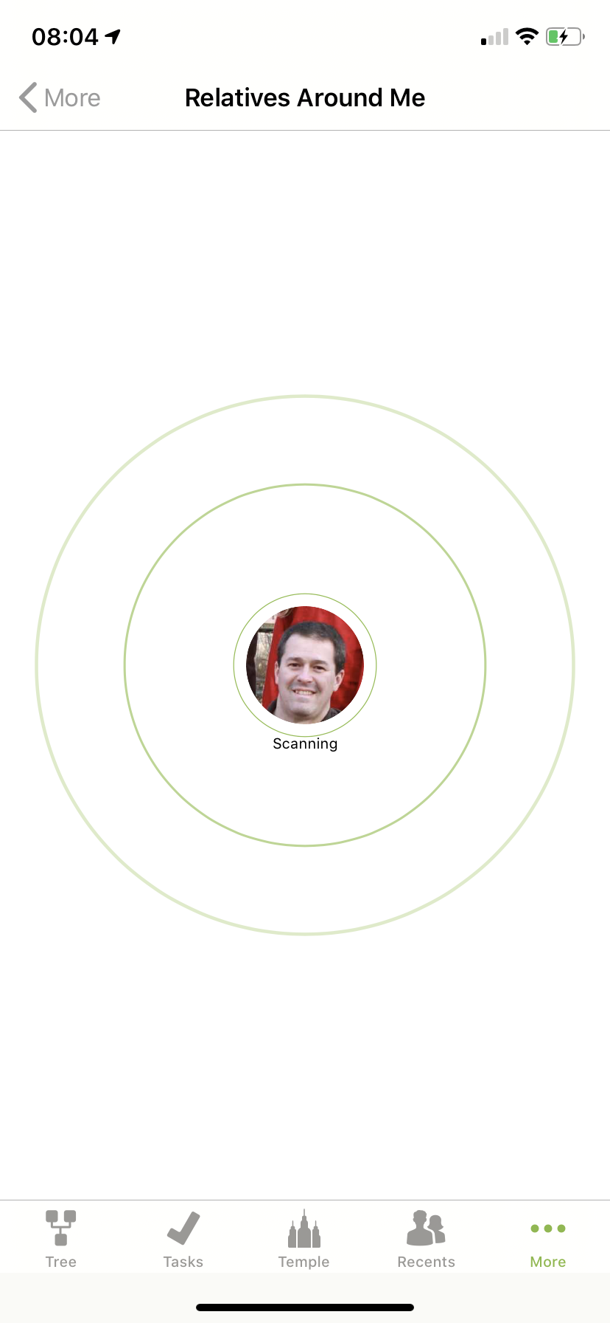
Relative Finder Exercise
Open “Family Tree” app
Click on “More…”
Select “Relatives Around Me”
Click on “Scan for Friends”
Talk to those around you to discuss how you are related
Notes:
David Mitchell - 5 minutes, should be over by 1:30

Slide 9
Submitting Names for Ordinances

Slide 10
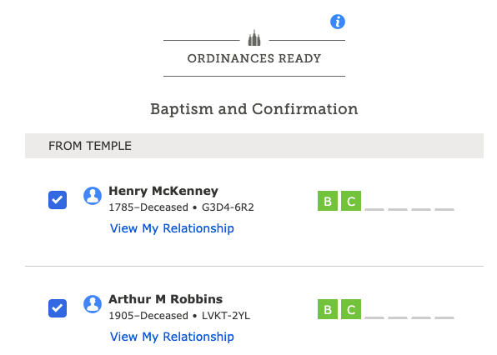
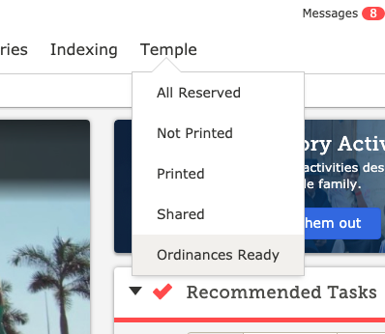
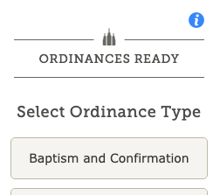
Baptism ordinance walk through in Family Search (1)
Notes:
Baptism ordinance in Family Search (from finding to printing)

Slide 11
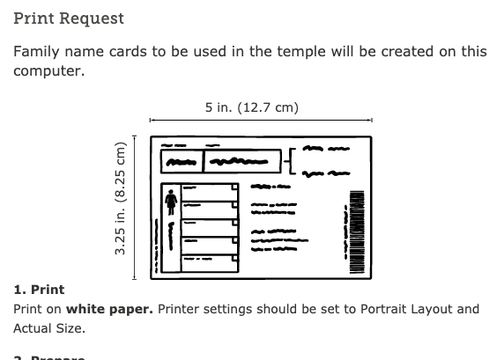
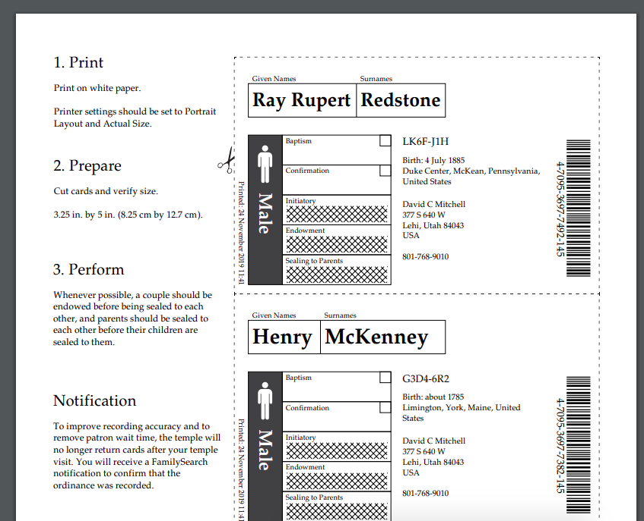
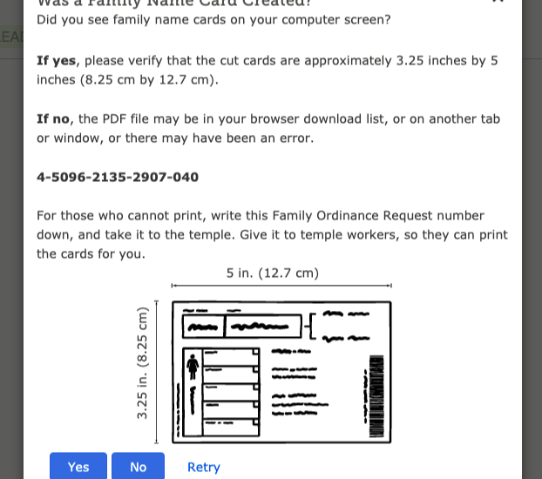
Baptism ordinance walk through in Family Search (2)
Notes:
Baptism ordinance in Family Search (from finding to printing)

Slide 12
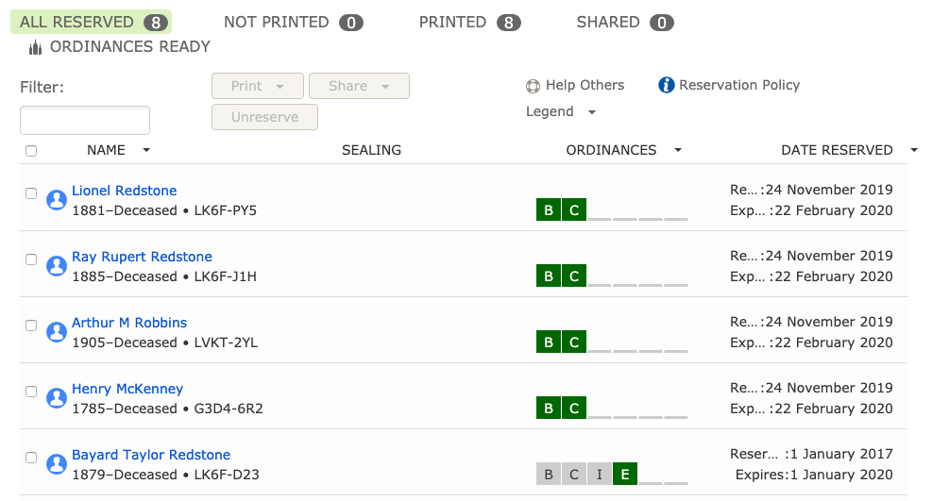
Baptism ordinance walk through in Family Search (3)

Slide 13
Becoming Acquainted with Ancestors

Slide 14
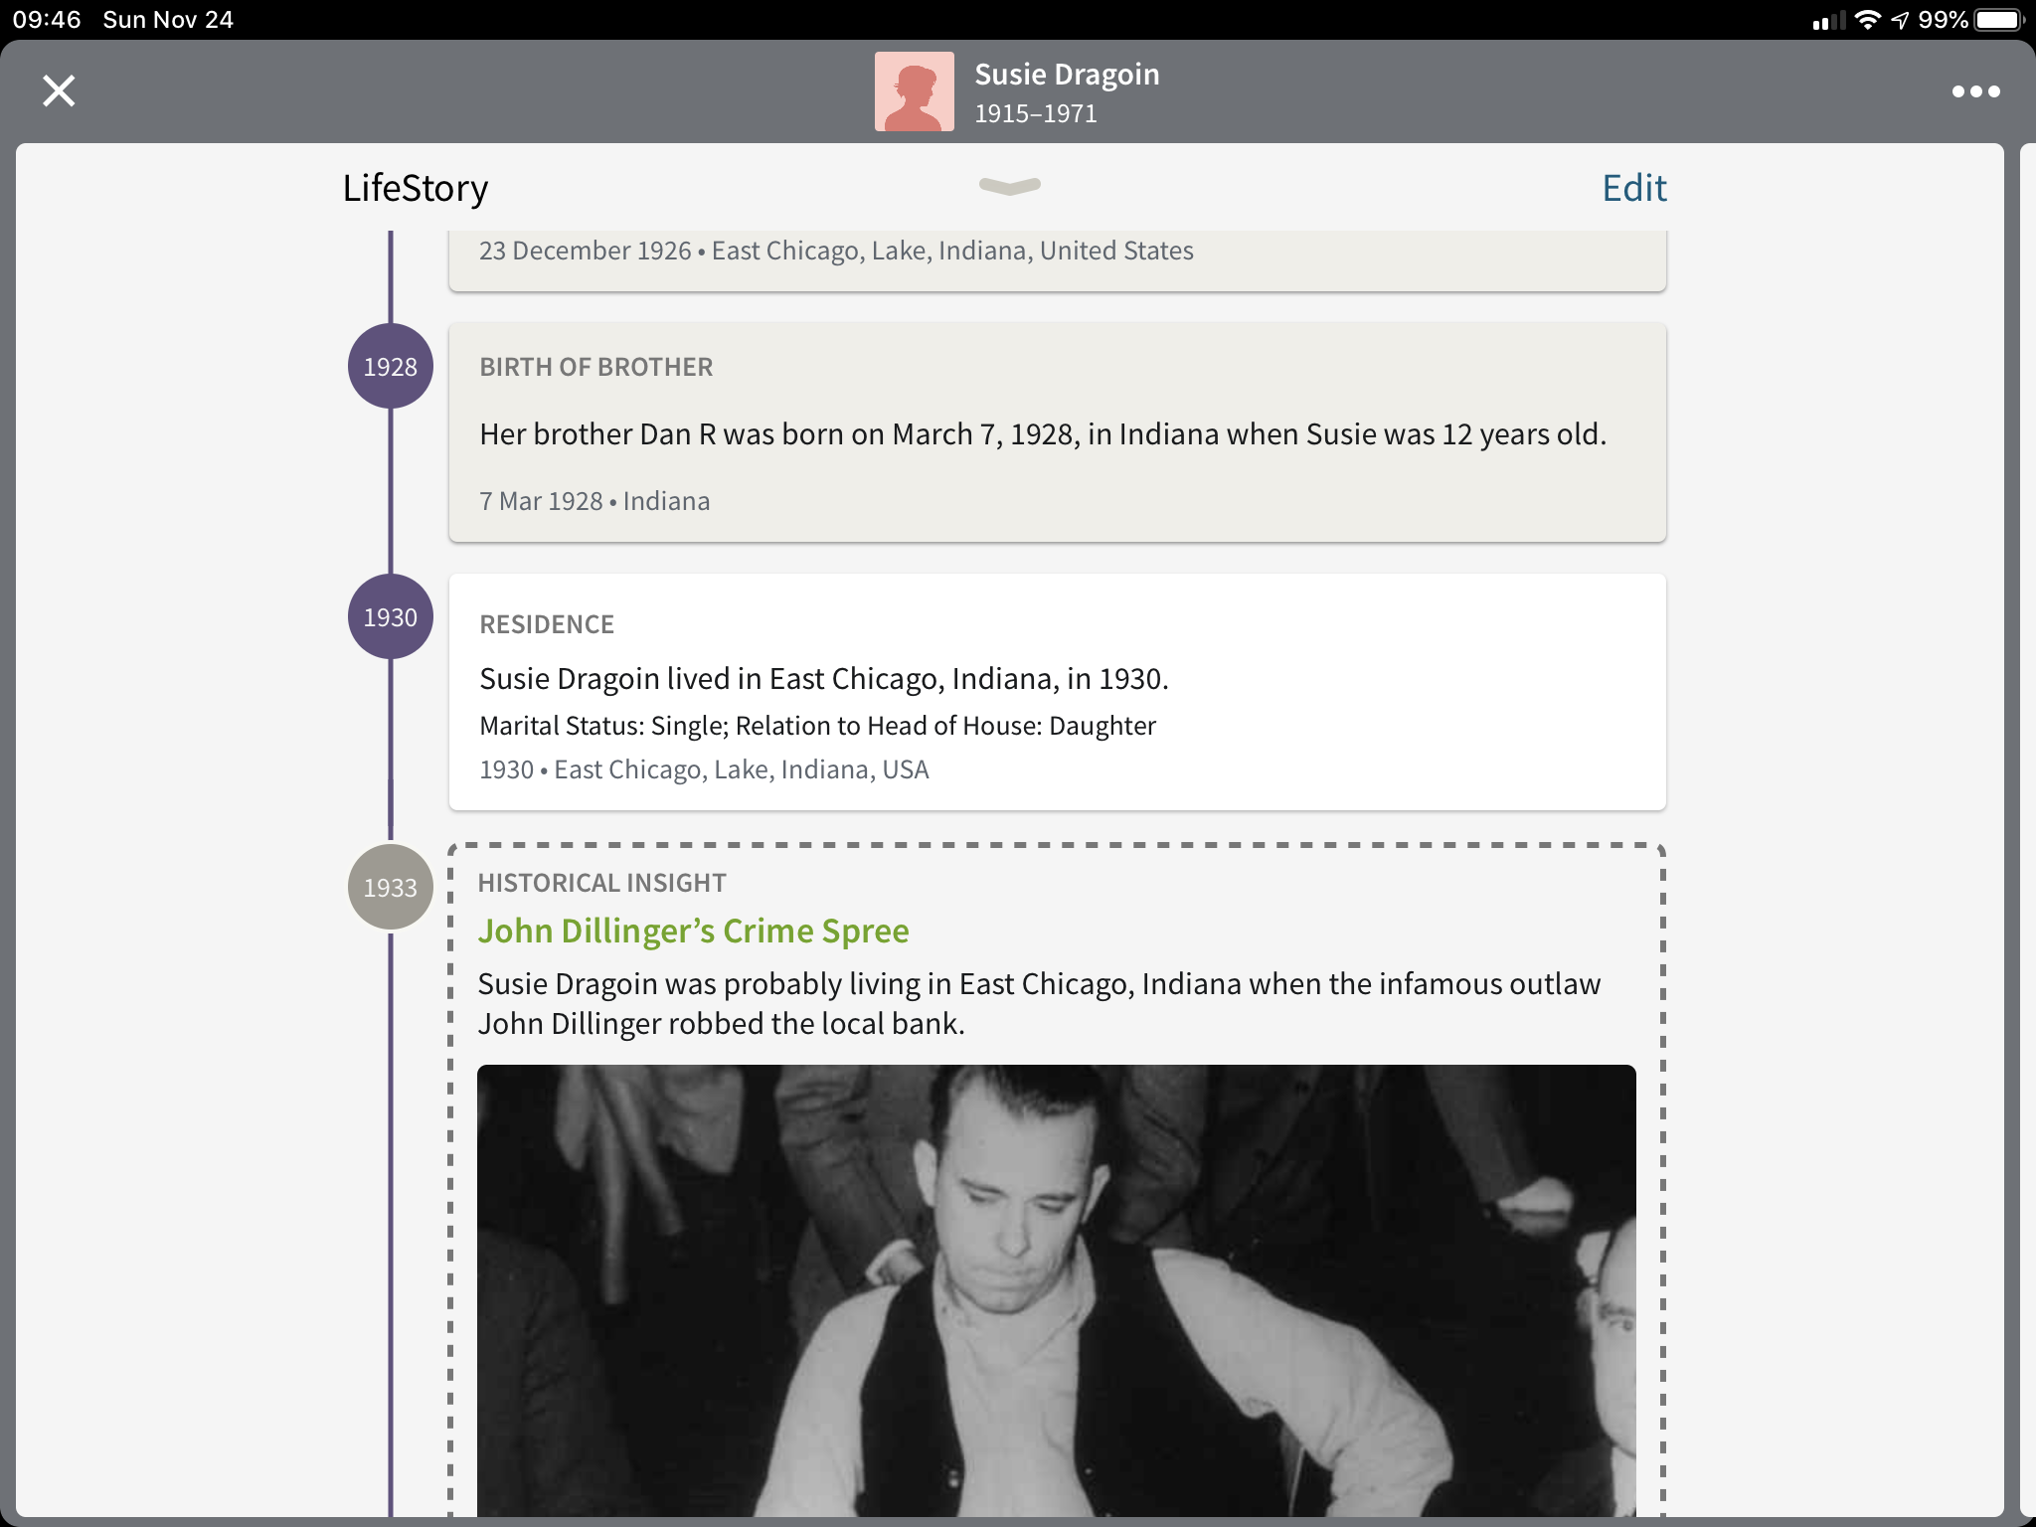
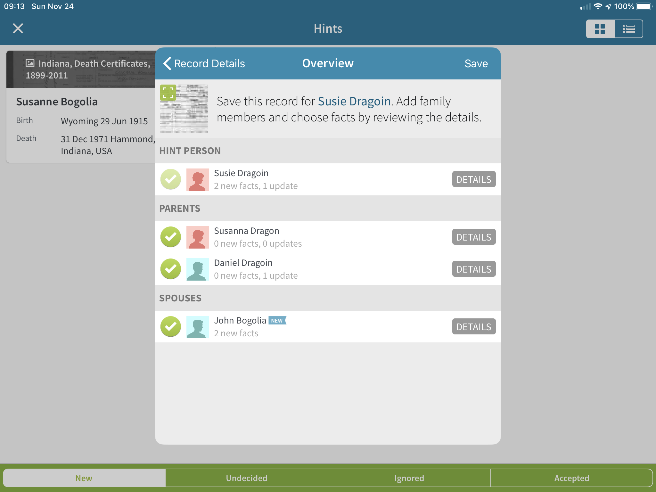
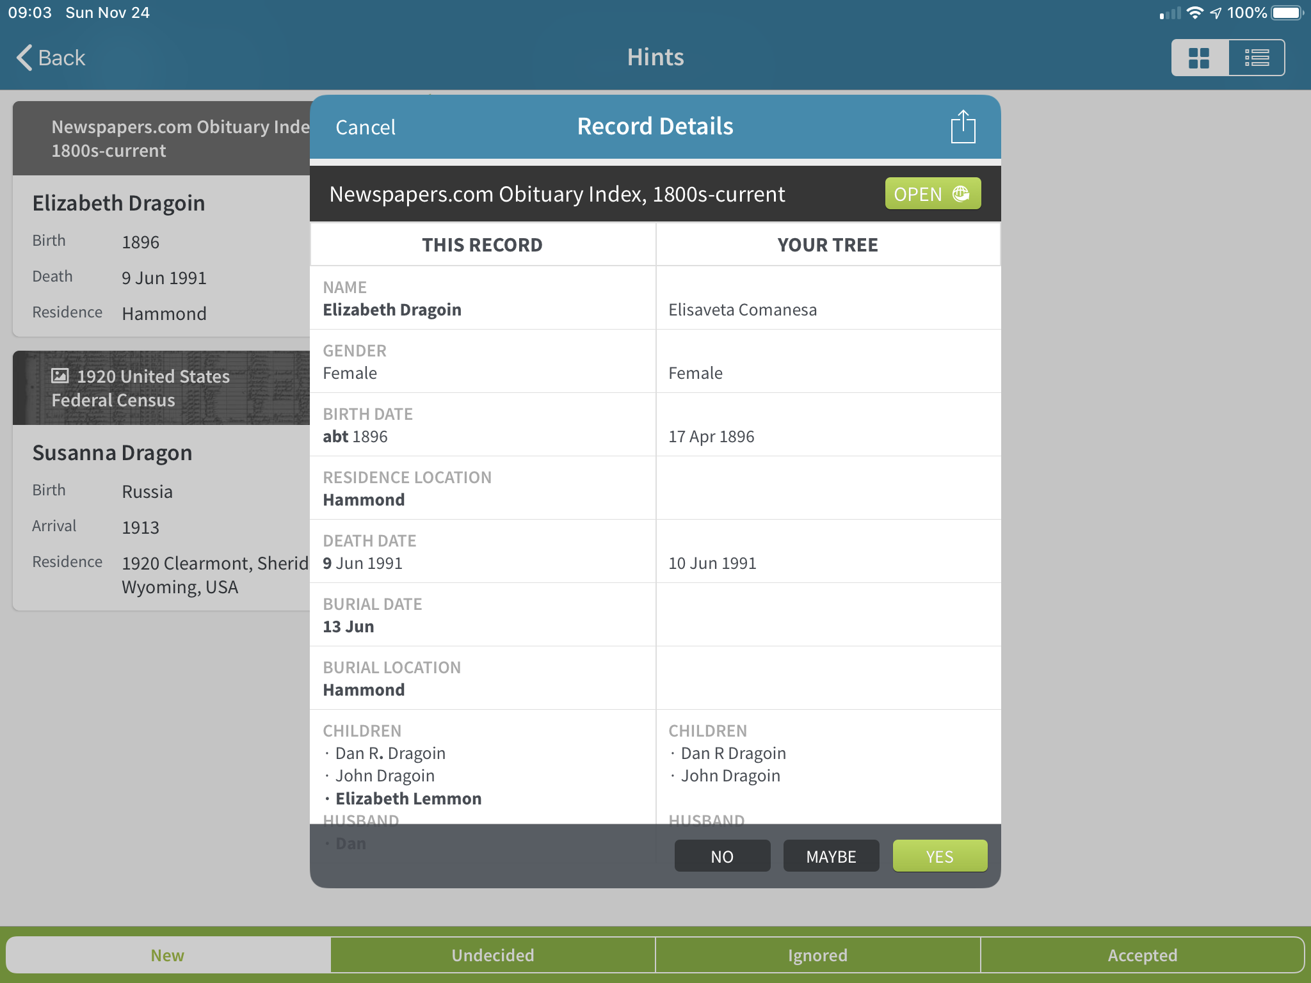
Ancestry App - Using hints to bridge generations
Notes:
Should be done by 1:40

Slide 15
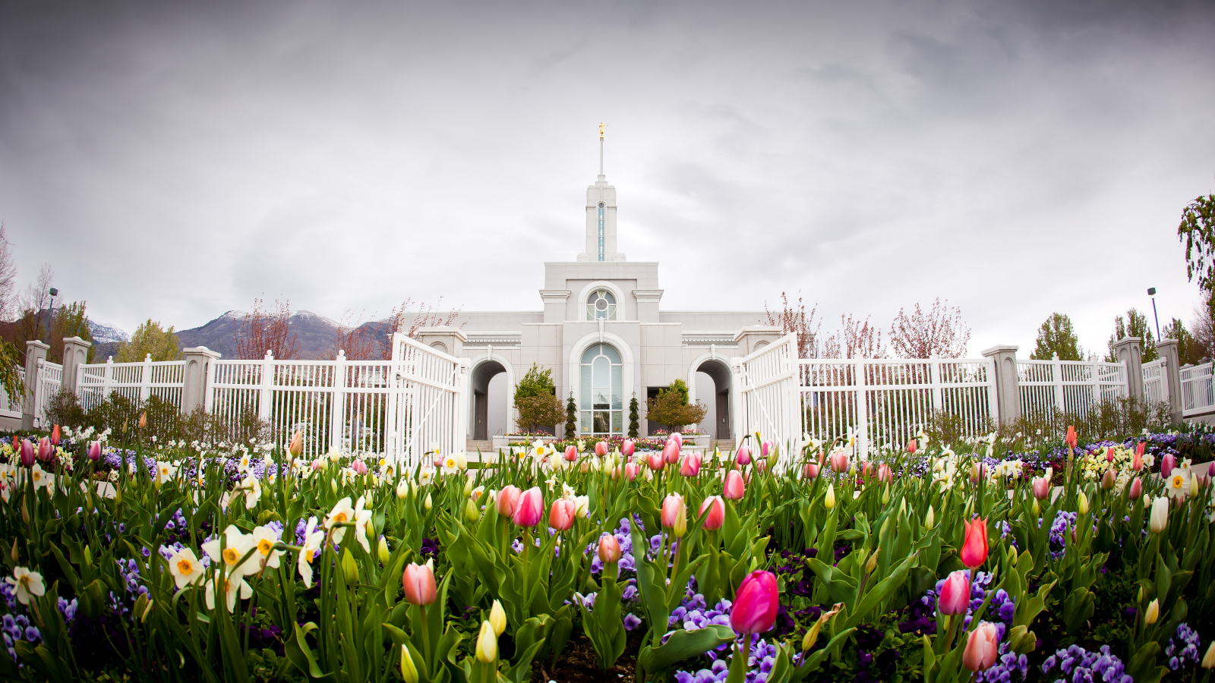
Home Centered Activities
Notes:
Lauren Andrews

Slide 16

Weekly prompts
For example...
Visit Saratoga Springs Temple site
Creative Journaling
Upload photos to Family Search
Family Search resources

Slide 17
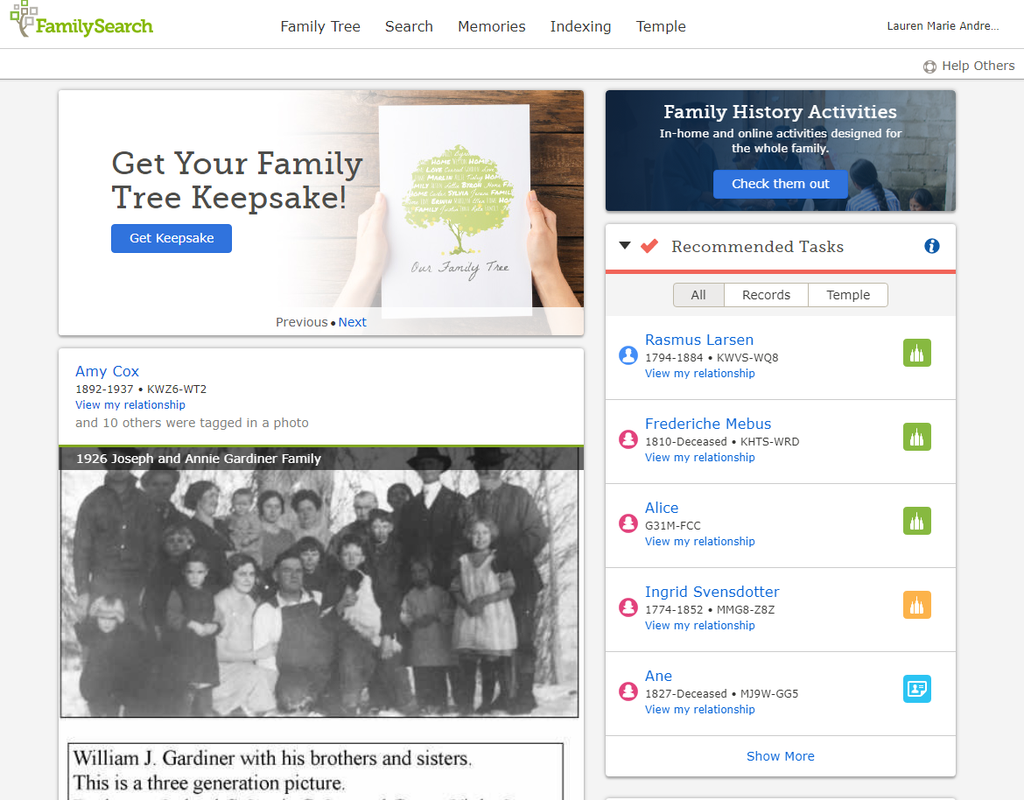

Slide 18
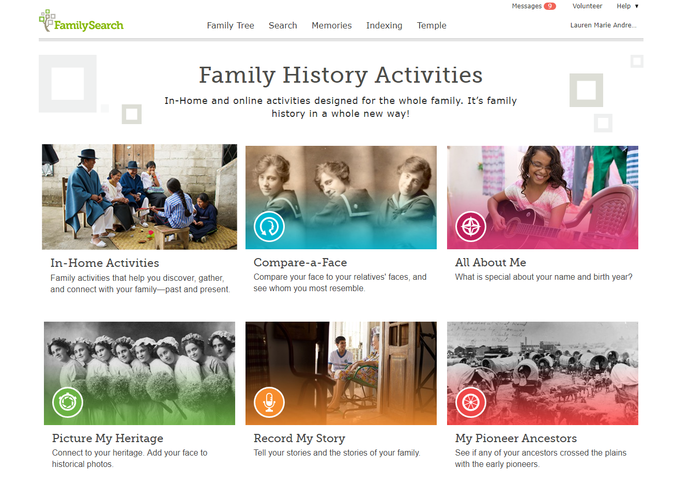
Activities and Resources
Notes:
Should be done by 1:50

Slide 19
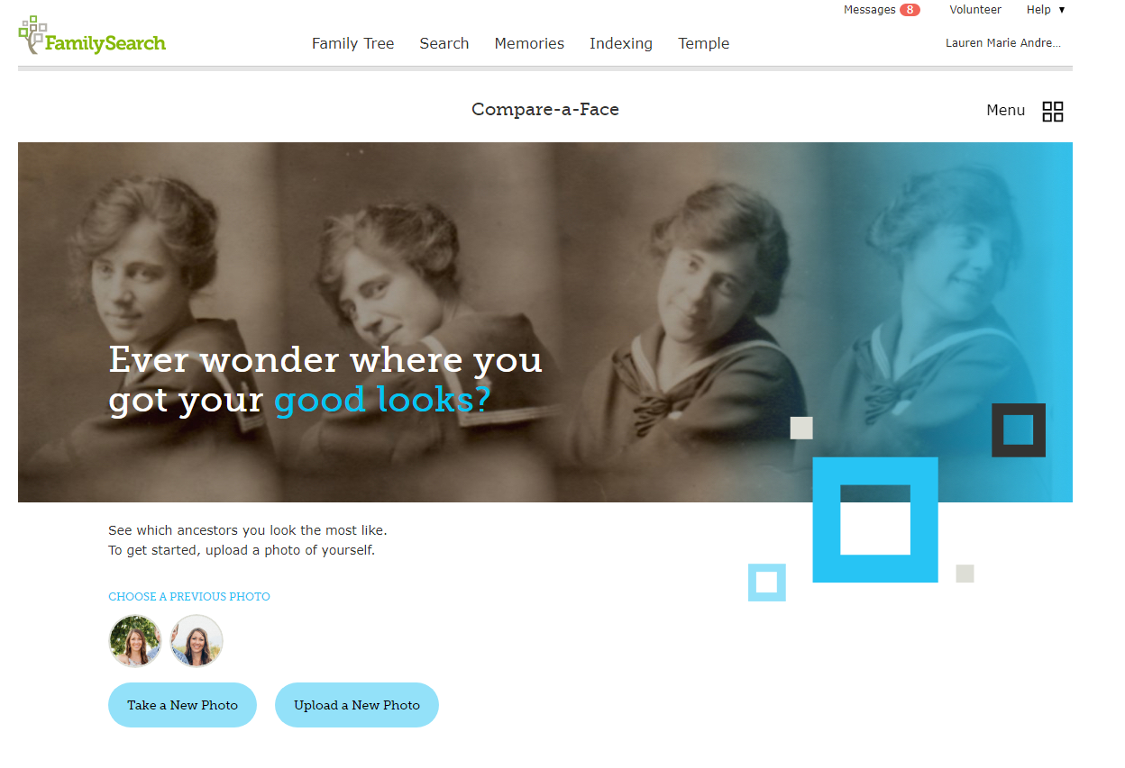

Slide 20
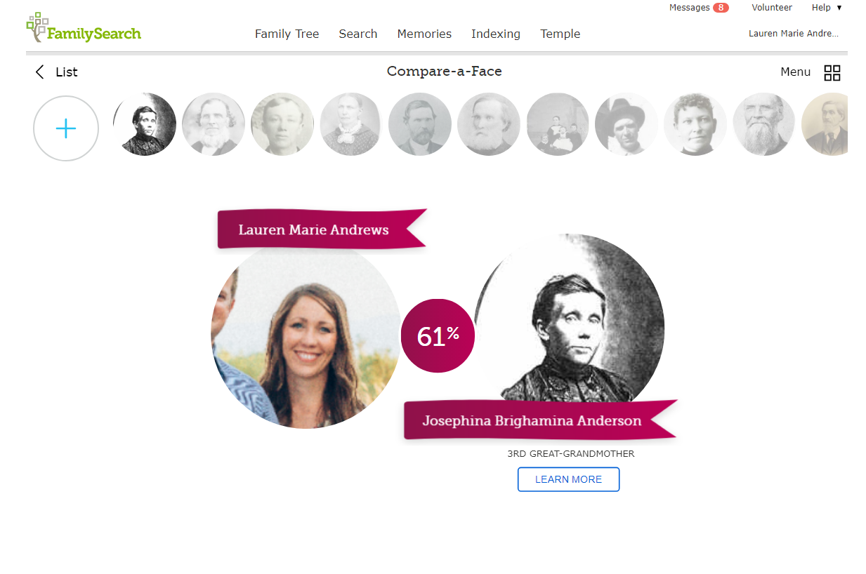

Slide 21
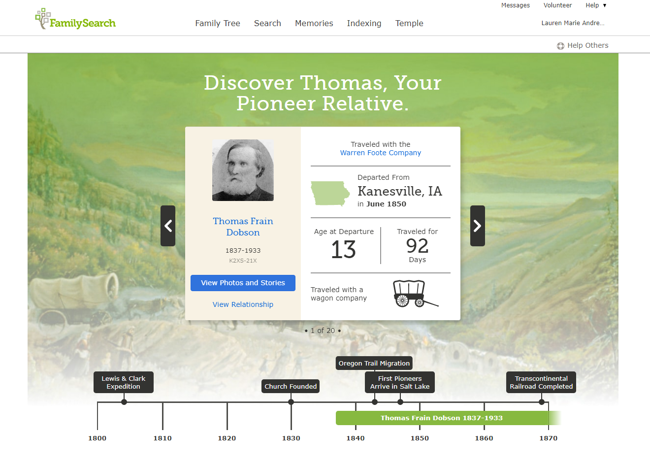

Slide 22
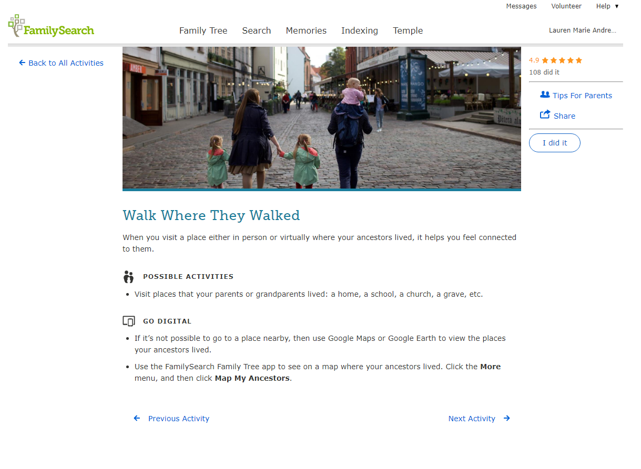

Slide 23
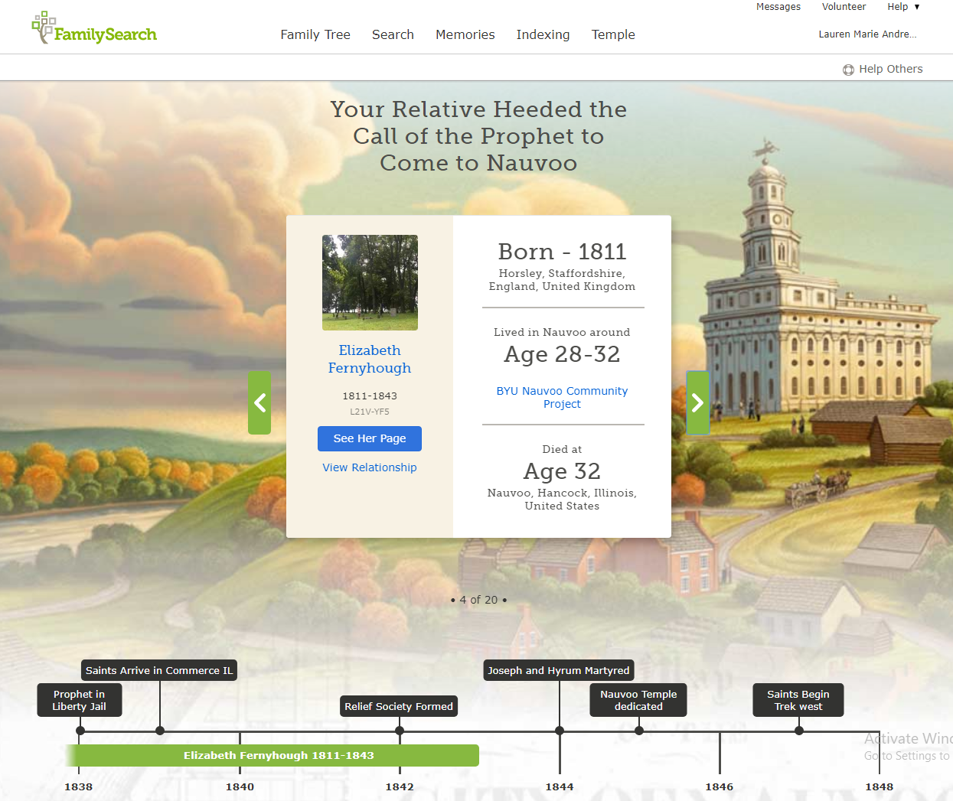

Slide 24
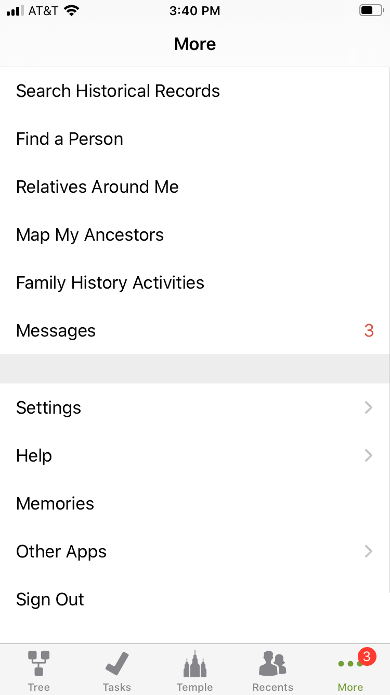
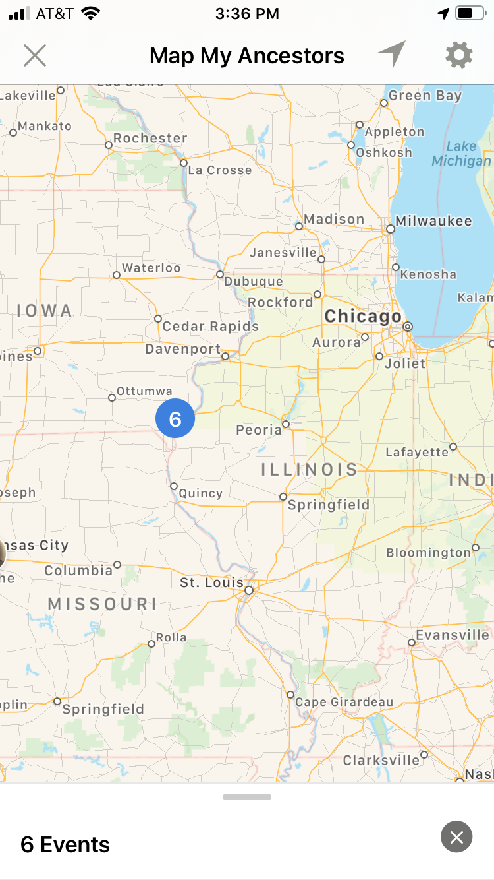
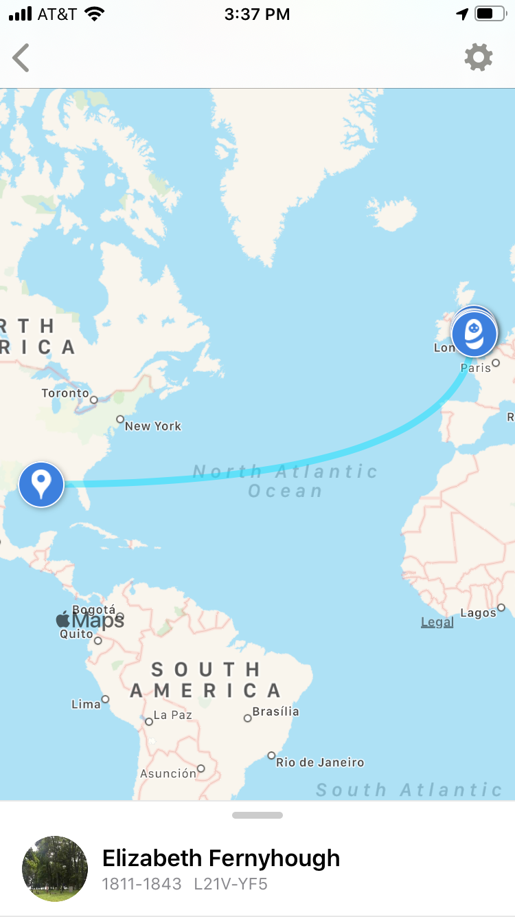

Slide 25
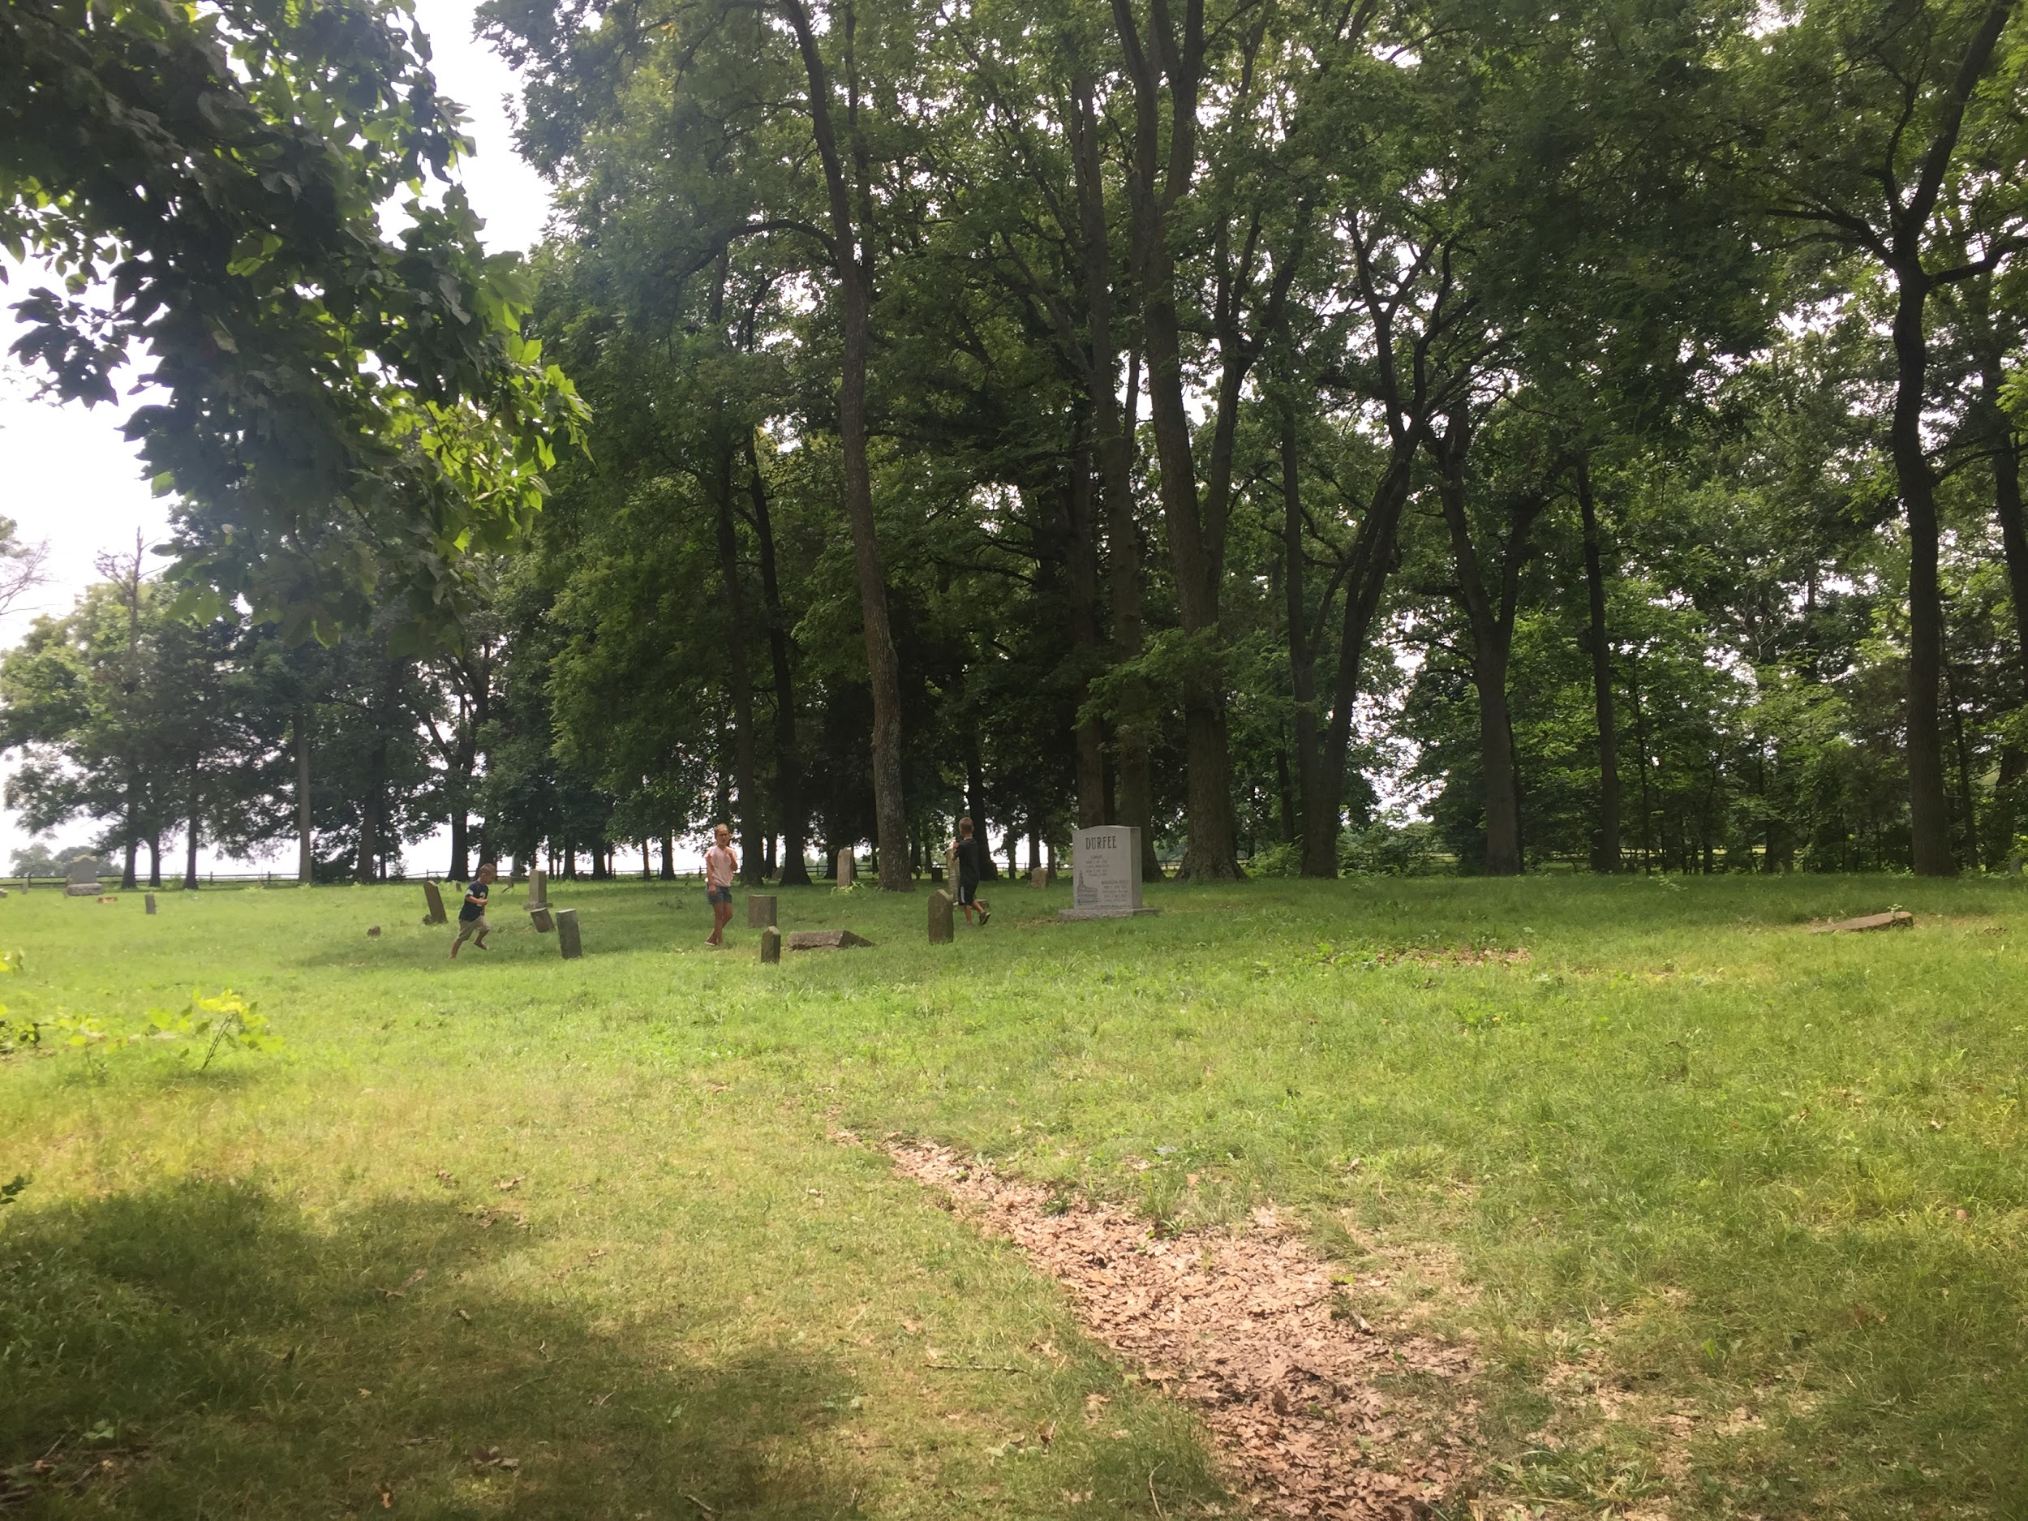

Slide 26
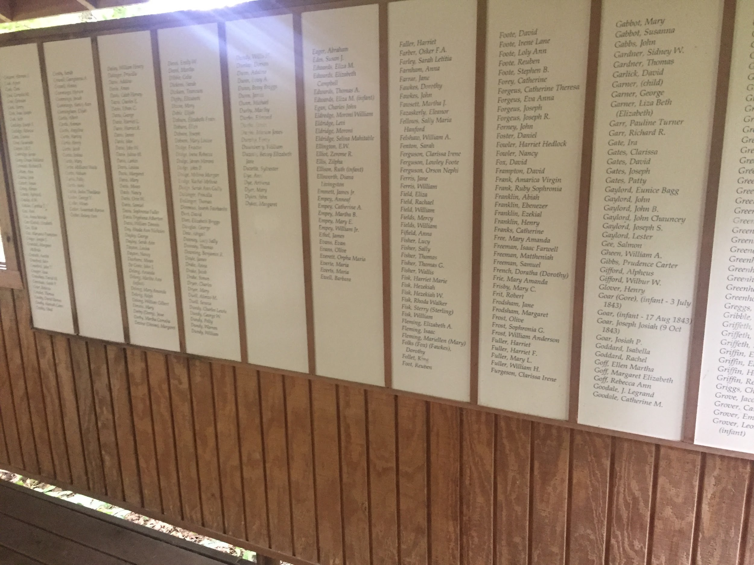
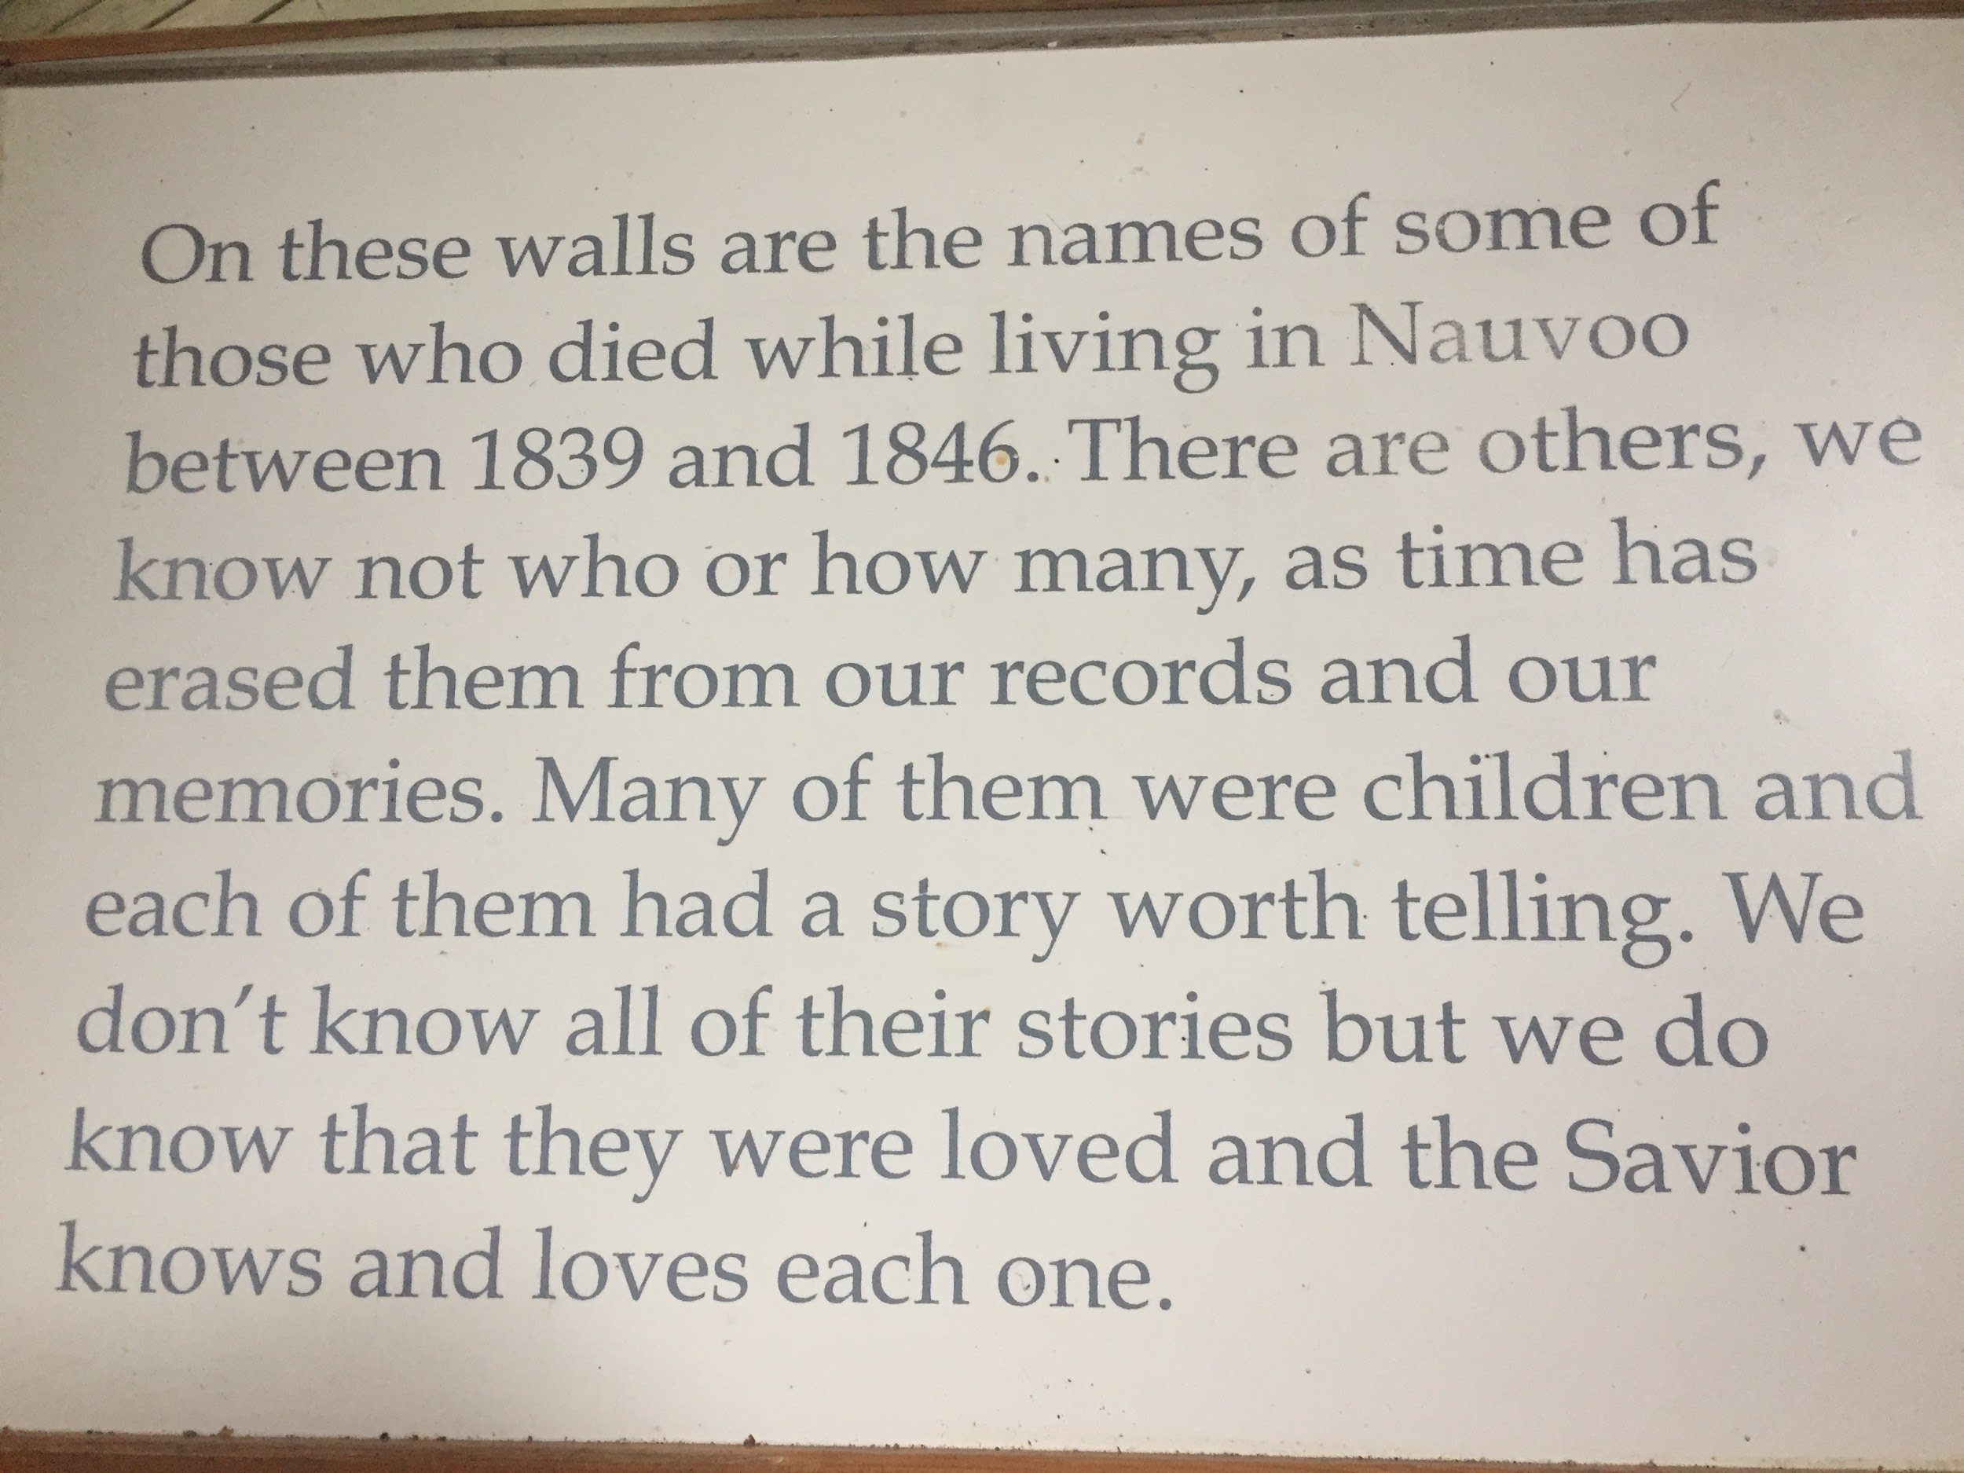

Slide 27
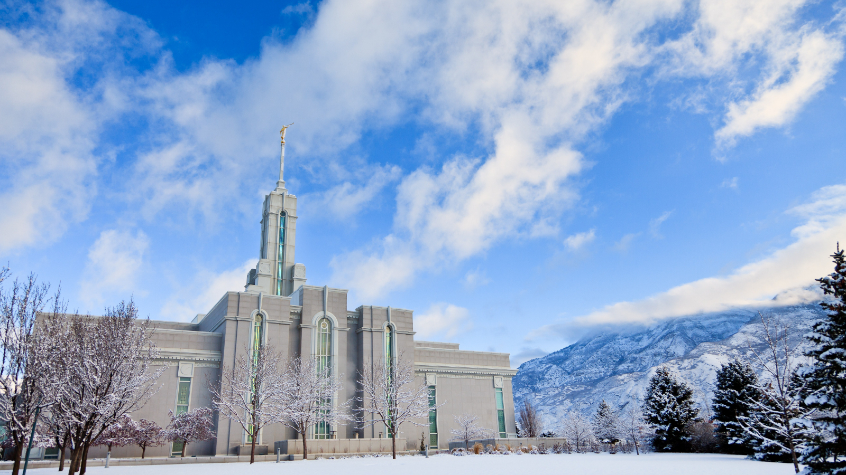
Ward Activities for the Coming Year
Notes:
Kristen Watson

Slide 28
A Year of Activities
Q1 - Family Search Center
Q2 - Cultural Dinner
Q3 - Pioneer Celebration
Q4 - Temple Week
Notes:
Should be done by 1:53

Slide 29
Closing Remarks
Brother and Sister Brown
Bishop Willes
Notes:
7 minutes total
2 for Browns
5 for Bishop

